Slide 1
ANESTHESIA FOR Emergency THORACIC SURGERY
By Eyayalem M. (Assistant. Professor)
Feb 2025

Slide 2
Prepare your cranium for further insertion of Knowledge and skill!!
Are you Ready ?
Here we go!!

Slide 3
LEARNING OUTCOMES (Objectives)
At the end of the module the learner will be able to:
Describe the anatomy of the thorax relevant to thoracic surgery
Discuss the physiology of the thorax relevant to thoracic surgery
Explain the effect of different drugs on the respiratory and cardiovascular system
Describe the common pathophysiology of thoracic emergencies.
Perform preoperative anesthetic evaluation for thoracic emergency surgery

Slide 4
LEARNING OUTCOMES (Objectives)
Interpret common investigations and imaging modality results of thoracic emergency
Discuss the effects of positioning, relaxation, and anesthesia on respiratory mechanics.
Optimize patients for thoracic emergency surgery
Perform DLI for thoracic emergency surgeries

Slide 5
LEARNING OUTCOMES (Objectives)
Manage one-lung ventilation during thoracic emergency surgeries
Manage intraoperative anesthesia for thoracic emergency surgeries
Manage postoperative pain for thoracic emergency surgeries
Manage postoperative complications associated with thoracic emergency procedures
Participate in the management of anesthesia for elective thoracic surgical procedures

Slide 6
Absences will result in Course incomplete
Take care ????
It is serious …………………..

Slide 7
What is Thoracic Anesthesia?
Definition:
A specialized branch of anesthesia focused on surgeries involving the thorax (chest), including the lungs, pleura, mediastinum, esophagus, and chest wall.
Common procedures:
Lobectomy, pneumonectomy
Esophagectomy
Mediastinal tumor resection
Thoracoscopy (VATS)

Slide 8
Unique Challenges in Thoracic Anesthesia
Physiological challenges:
One-lung ventilation (OLV) requirements.
Hypoxia during OLV.
Ventilation-perfusion mismatch.
Surgical challenges:
Lateral decubitus positioning.
Risk of hemorrhage or airway injury.
Patient factors:
Often patients with compromised lung function (e.g., COPD, lung cancer).

Slide 9
Anatomy and Physiology

Slide 10
Physiologic/Anatomy Respiratory system
The knowledge of certain aspects of thoracic anatomical arrangements is of great importance to the thoracic anesthetist.
It assists in the correct positioning of endobronchial tubes, the identification of diseased lobes, in an understanding of the proposed surgery and also the potential complications that might occur.

Slide 11
THORACIC CAVITY
The thoracic cavity is formed by the ribs laterally, sternum anteriorly,vertebral column posteriorly, and by the diaphragm and thoracic inlet inferiorly and superiorly, respectively.
The thoracic cavity encompasses the lungs, which provide oxygenation of venous blood, excretion of carbon dioxide.

Slide 12
Function of the lungs
The lungs has respiratory and non respiratory function.
Respiratory function is oxygenation of venous blood
Non-respiratory function excretion of carbon dioxide, and metabolism of endogenous compounds.

Slide 13
Non respiratory function
Defense mechanism
Maintenance of water balance
Regulation of body temperature
Regulation of acid base balance
Metabolism of biologically active substances

Slide 14
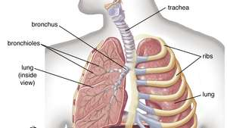

Slide 15
Physiologic Anatomy of Respiratory system
The respiratory system can be divided into the upper
airway, larynx and tracheobronchial tree
The tracheobronchial tree can be subdivided into the conducting and respiratory zones.

Slide 16
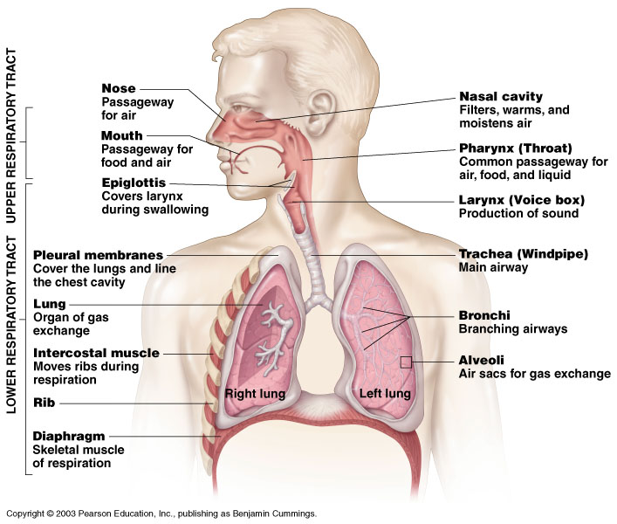
Human Respiratory System
Figure 10.1

Slide 17
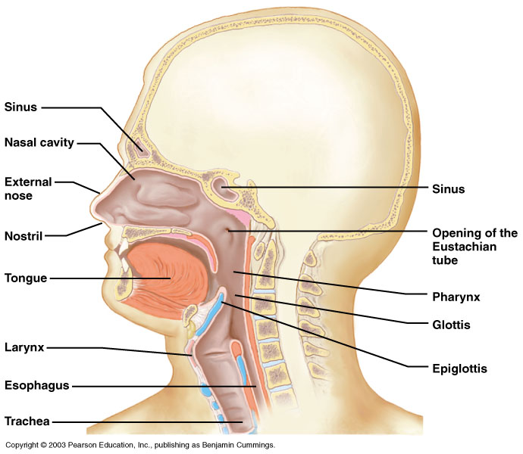
Components of the Upper Respiratory Tract
Figure 10.2

Slide 18
Upper Respiratory Tract Functions
Passageway for respiration
Receptors for smell
Filters incoming air to filter larger foreign material
Moistens and warms incoming air
Resonating chambers for voice

Slide 19
Upper airway
Nasal hairs filter any large inhaled particles.
The mucosa promotes humidification and warming of inhaled air.
Endotracheal and tracheostomy tubes bypass the upper airway ( clinical relevance ?????)
Notes:
Inhaling cold, dry gases results in increased mucus viscosity, which impairs the mucociliary escalator. This causes:
1. accumulation of mucus in lower airways;
2. an increased risk of pulmonary infection;
3. microatelectasis.

Slide 20
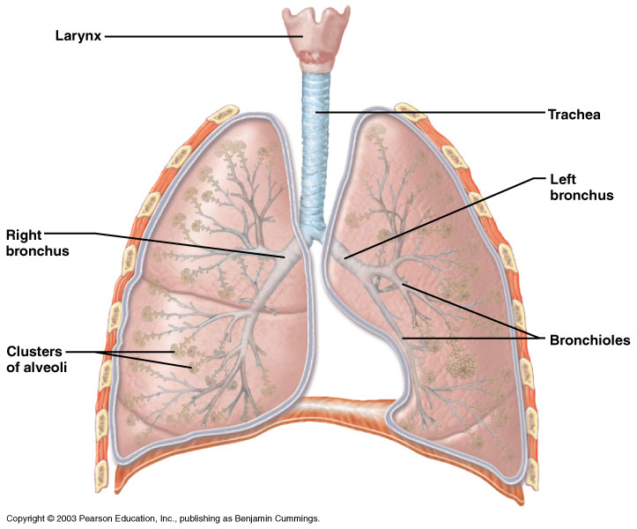
Components of the Lower Respiratory Tract
Figure 10.3

Slide 21
Lower Respiratory Tract
Functions:
Larynx: maintains an open airway, routes food and air appropriately, assists in sound production
Trachea: transports air to and from lungs
Bronchi: branch into lungs
Lungs: transport air to alveoli for gas exchange

Slide 22
Larynx
The larynx is located in the anterior compartment of the neck, suspended from the hyoid bone, and spanning between C4 and C5.
During inhalation the vocal cords are in an abducted position, to reduce resistance to inward gas flow.
In exhalation the cords adduct slightly, increasing the resistance to gas flow, which results in a positive end-expiratory pressure (PEEP) of 3–4 cmH2O.
Advantage ?????
Disadvantage of high PEEP?????
Should be avoided ?????
The slight adduction of the vocal cords during exhalation, creating a natural PEEP (3–4 cmH₂O), has both advantages and disadvantages:
Advantages of PEEP:
Prevents Alveolar Collapse: Maintains alveolar recruitment, reducing atelectasis.
Improves Oxygenation: Increases functional residual capacity (FRC) and enhances gas exchange.
Reduces Work of Breathing: Supports spontaneous breathing by stabilizing the airways.
Disadvantages of High PEEP:
Barotrauma: Excessive PEEP can over-distend alveoli, leading to pneumothorax or volutrauma.
Hemodynamic Effects: High intrathoracic pressure can reduce venous return, causing hypotension and decreased cardiac output.
Impaired Renal Function: Reduced cardiac output can affect renal perfusion.
Notes:
( vocalization, preventing alveolar collapse and maintain FRC)
Raised intracranial pressure (ICP) – increased intrathoracic pressure may hinder venous drainage from the cerebral venous sinuses,
leading to an increase in ICP.
Tonsillectomy – raised venous pressure may increase bleeding at the tonsillar bed, obstructing the surgeon’s view of the operative field

Slide 23
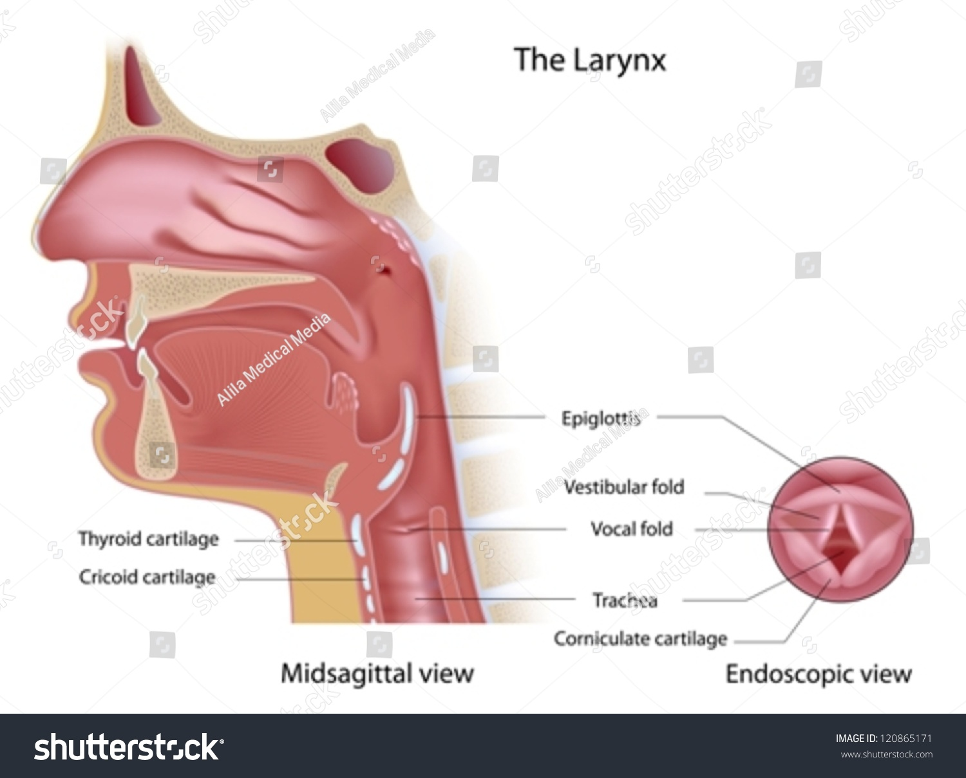
Larynx

Slide 24
Trachea
The trachea
Begins at C6, level of cricoid cartilage
Approximately 11 cm in length
At T5, bifurcates into right and left mainstem bronchi
Exterior-is made of C shaped cartilage with soft tissue in between them
Interior-is lined with respiratory epithelium
*cool fact* the esophagus is right behind the trachea, and this is why it has C shaped cartilage instead of full rings

Slide 25
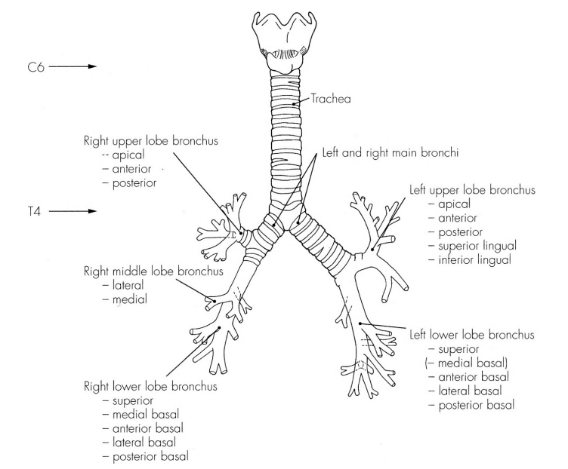
Trachea

Slide 26
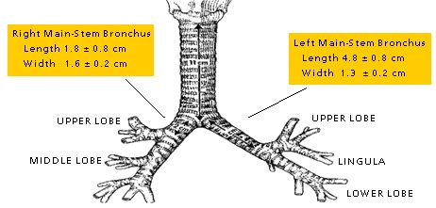
Trachea

Slide 27
Trachea
Right mainstem bronchus is shorter (upper lobe takeoff after 2 – 2.5 cm), wider (supplies the larger lung), and more vertically placed

Slide 28
Bronchial trees
The right lung has three lobes (upper, middle and lower), and the left has two lobes (upper and lower)
There are 10 bronchopulmonary segments on the right (three upper lobe, two middle lobe, five lower lobe), and nine bronchopulmonary segments on the left (five upper lobe, four lower lobe).
The terminal bronchioles occur at the 16th airway generation, the last airway generation of the conducting zone
Notes:
The adult right main bronchus is about 2.5 cm long before it initially branches into lobar bronchi. However, in 10% of adults, the right upper lobe bronchus departs from the right main stem bronchus less than 2.5 cm from the carina. Furthermore, in 2% to 3% of adults, the right upper lobe bronchus opens into the trachea, superior to the carina.

Slide 29
Tracheobronchial tree:
The tracheobronchial tree consists of a series of airways that divide, becoming progressively narrower with each division.
In total, there are 23 divisions or generations between the trachea and the alveoli
The tracheobronchial tree is subdivided into the conducting zone (airway generations 0–16) and the respiratory zone (generations 17–23).

Slide 30
Bronchial trees

Slide 31
Airway generations (divisions)

Slide 32
Airway generations (divisions)

Slide 33
Airway generations
The conducting airways:- conducting air from the larynx to the respiratory zone ( Anatomical dead space = 150 ml) .
The trachea starts at the lower border of the cricoid cartilage (C6 vertebral level) and bifurcates at the carina (T4/5 level).
The trachea divides into the right and left main bronchi.
Its length 10-12cm and diameter 15-20mm
Comprises 16-20 C shaped cartilage rings, cartilages are joined vertically by fibroelastic tissue and closed posteriorly by non striated trachealis muscle

Slide 34
Airway generations
The right main bronchus is shorter, wider and more vertical than the left
In the adult, the right bronchus leaves the trachea at approximately 25 degrees from the vertical tracheal axis, whereas the angle of the left bronchus is about 45 degrees
????? Anesthetic implication

Slide 36
Airway generations

Slide 37
Alveoli
surface area increases significantly at the periphery of the lung
Alveoli ~ 300 million
~140 m² of surface area

Slide 38
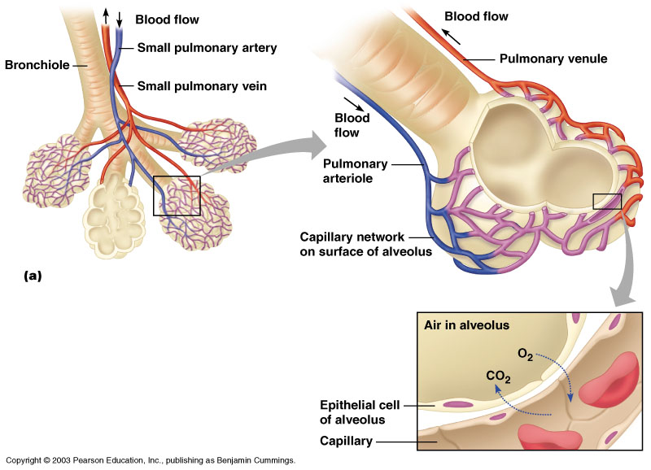
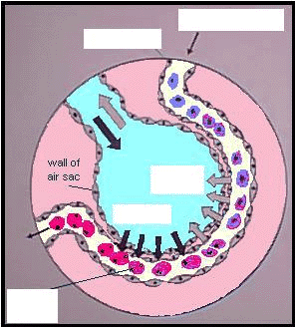
Gas Exchange Between the Blood and Alveoli
Surfactant ::
lowering surface tension at the air–liquid interface and thus preventing alveolar collapse at end-expiration.
interacting with and subsequent killing of pathogens or preventing their dissemination, and
Modulating immune responses.

Slide 39
Breathing Muscles
Eupnea-normal breathing
Inspiration
Diaphragm
External intercostal muscles
Expiration
Internal intercostal
Abdominal muscles
*remember that more muscles are used when a person is breathing heavily

Slide 40
MEDIASTINUM
The mediastinum is the region between the 2 pleural sacs .
contains the heart, the great vessels, and the thymus gland.
For purposes of description, the mediastinum is divided into 4 subdivisions (middle, posterior, anterior, and superior compartments).

Slide 41
MEDIASTINUM
The middle mediastinum contains the pericardium with the adjacent phrenic nerves, the heart, and the great vessels emanating to and from it.
the superior mediastinum contains the thymus, great vessels, and several nerves.

Slide 42
MEDIASTINUM
The posterior mediastinum, contains the thoracic aorta, thoracic duct, azygos and hemiazygos veins, esophagus, and bifurcation of the trachea with the 2 bronchi.
The anterior mediastinum, contains lymphatic vessels, lymph nodes, and branches of the internal thoracic artery.

Slide 43
Circulation
Pulmonary artery branches, following bronchial tree and gives rise to pulmonary capillary branches → capillary nets that course over alveoli → reform into pulmonary vein
Bronchial arterial system arises from systemic circulation (aorta, intercostals) and comprises 1% of Cardiac Output

Slide 44
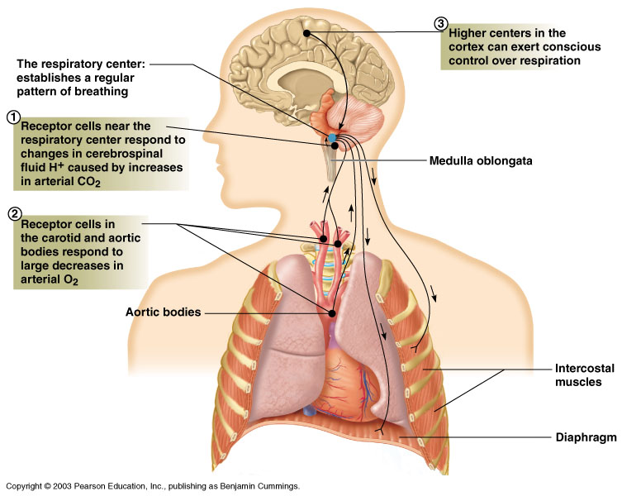
Regulation of Breathing
Figure 10.13

Slide 45
Regulation of Breathing: Nervous System Involvement
Respiratory center in the medulla oblongata: establishes basic breathing pattern
Chemical receptors: monitor carbon dioxide, hydrogen ions, and oxygen levels
Medulla: sensitive to hydrogen ions in cerebrospinal fluid resulting from carbon dioxide in blood

Slide 46
Regulation of Breathing: Nervous System Involvement
Carotid and aortic bodies: sensitive to carbon dioxide, pH, and oxygen levels
Conscious control: resides in higher brain centers; ability to modify breath is limited

Slide 47
Four Respiration Processes
Breathing (ventilation): air in to and out of lungs
External respiration: gas exchange between air and blood
Internal respiration: gas exchange between blood and tissues
Cellular respiration: oxygen use to produce ATP, carbon dioxide as waste

